Slide 1

CE 673: Instrumentation Laboratory & Field Practices in Geoinformatics
Field Survey Presentation
Mentor:
Dr. Onkar Dikshit
TA:
Rashmi Malik
Guidance:
Hari Babu Sir
Shitla Sir
Maurya Sir
Group Member
Satyam Agnihotri 231030406
Anukul Dwivedi 231030402
Pramod Gandugade 231030405
Shubham Mishra 231030407
Sreekanth K S 231030409
2023-2024
Group 7

Slide 2
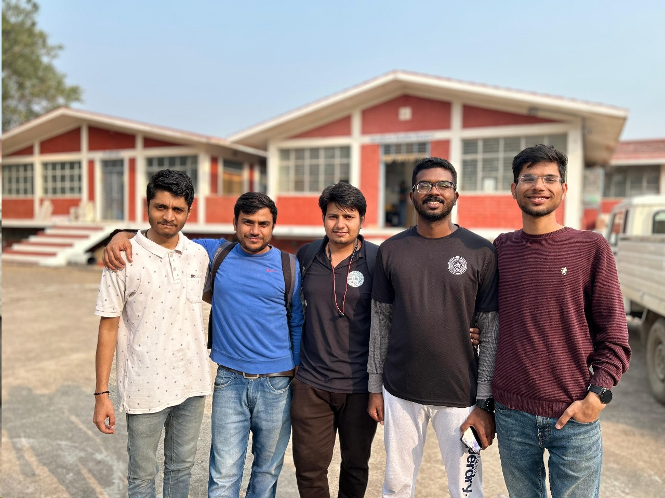
Agenda for Today
Objective.
Survey Camp Exercises
Topographic Map
Reconnaissance.
Control Point Establishment using GNSS.
Level Transfer using Auto Level .
Feature Mapping Using Total Station.
City Survey using Juno-3B.
Road Profile using Total Station.
Laboratory Exercise – I : Chain and Compass Survey.
Laboratory Exercise – II : EDMI calibration.
Laboratory Exercise – II : Total station traversing.

Slide 3
Time Line of survey camp
27 - Nov
Day 1
Reconnaissance
28 - Nov
Day 2
GNSS survey
29 - Nov
Day 3
JUNO city survey
Control point establishment
30 - Nov
Day 4
Auto levelling.
Transferring levels to CPs.
1 –Dec to 4 - Dec
Day 5 - 8
Total station survey.
Start of feature mappings
5 -Dec
Day 9
Road profile using TS.
Viva

Slide 4
Objective
To gain practical understanding and hands-on experience with a range of survey instruments.
To explore and appreciate the significance of reconnaissance surveys.
To appreciate the concept horizontal and vertical datum.
To learn the process of topographic map making.
To understand the precision of different surveying instrument and there appropriate applications.
To accurately measure and map out boundaries, features, and topography using chain and compass traversing.
To determine calibration parameters for EDMI.
To establish closed traverses using Total Stations and defining the precision on the basis of closing error.
To understanding the basic principals of surveying and there application.

Slide 5
Survey Camp
Reconnaissance.
Control Point Establishment using GNSS
Level transfer using Auto-level
Feature Mapping using TS
Map Making

Slide 6
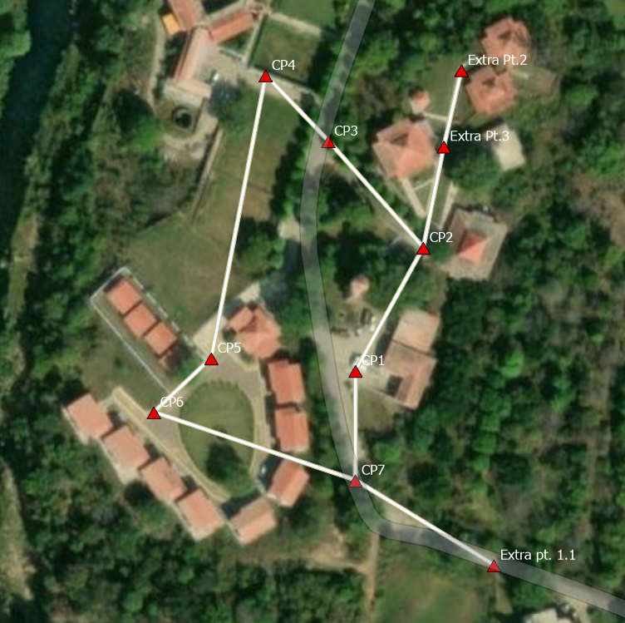
Reconnaissance
Decided Upon the area to be mapped.
Finalized features to be mapped.
First, needed to densify horizontal control.
Control points had to be intervisible and accessibility.
No obstructions for canopy for GNSS measurements.
Marked up Control points with paint and pegs.
Optimal Control Point to cover maximum area.
Control Points Identified : 7

Slide 7
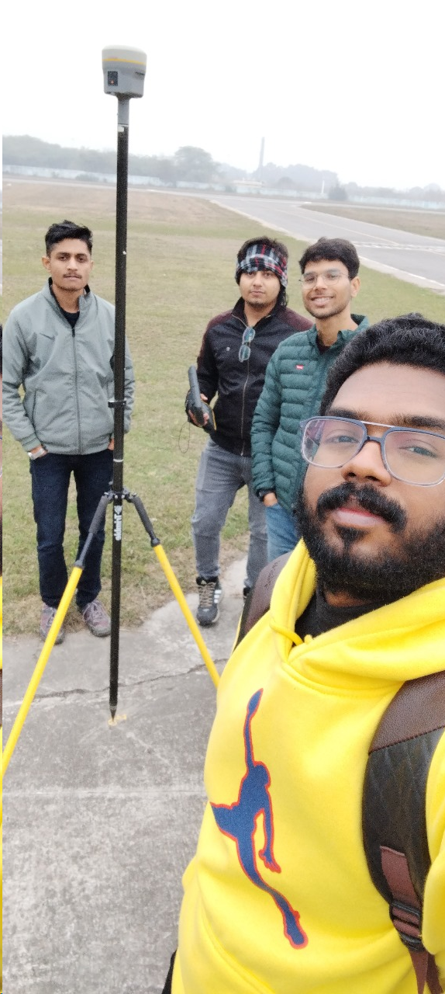
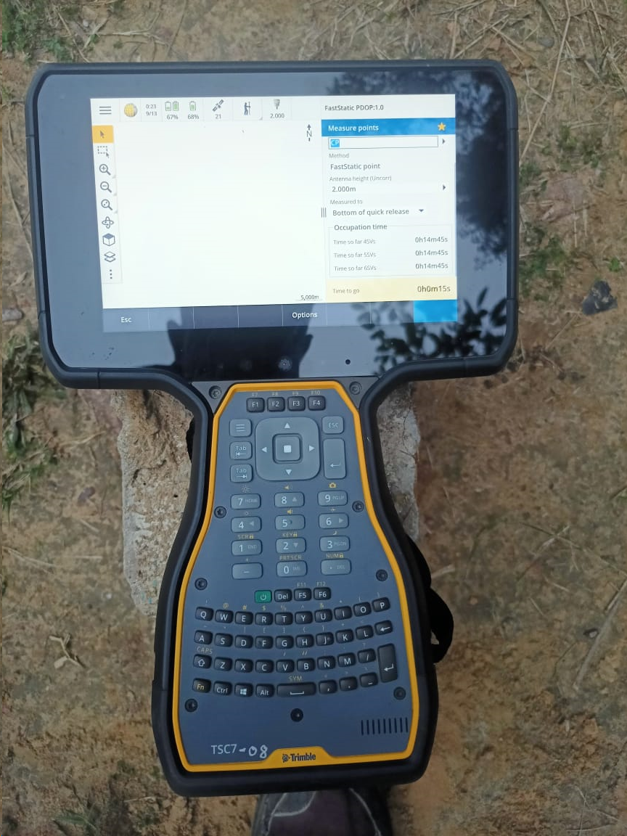
Control Point Establishment using GNSS
Instrument used : R10 GNSS receiver
GNSS survey for global coordinates of control points.
Rapid Static survey :15 min observation for each control Point.
Post Processing the data using TBC.
ID | Easting (Meter) | Northing (Meter) | Elevation (Meter) | Feature Code
Base1 | 486196.680 | 2781803.096 | 86.476
p1 | 486247.572 | 2781780.464 | 90.166 | control point
p1.1 | 486247.586 | 2781780.468 | 90.175 | control point1.1
p2 | 486172.050 | 2781805.955 | 85.781 | control point2
p3 | 486193.595 | 2781826.191 | 86.500 | control point3
p4 | 486256.771 | 2782034.917 | 79.764 | control point4
p5 | 486305.123 | 2782116.889 | 77.321 | control point5
p6 | 486213.978 | 2781932.148 | 82.154 | control point6
p7 | 486235.271 | 2781916.333 | 88.494 | control point7
p7.2 | 486237.472 | 2781907.557 | 84.043 | control point7.2
p8 | 486273.066 | 2781867.617 | 89.661 | control point8
p9 | 486247.664 | 2781821.501 | 89.900 | control point9

Slide 8
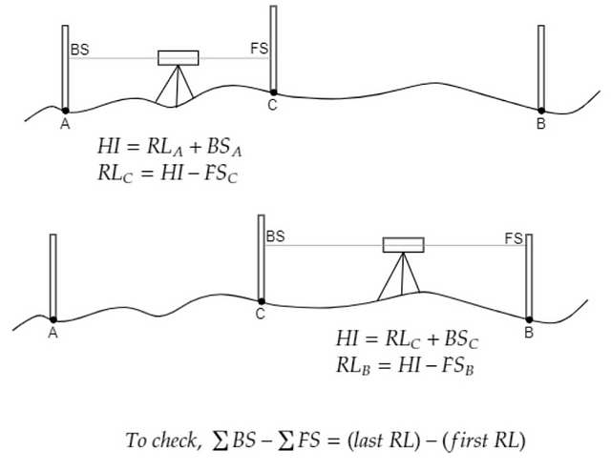
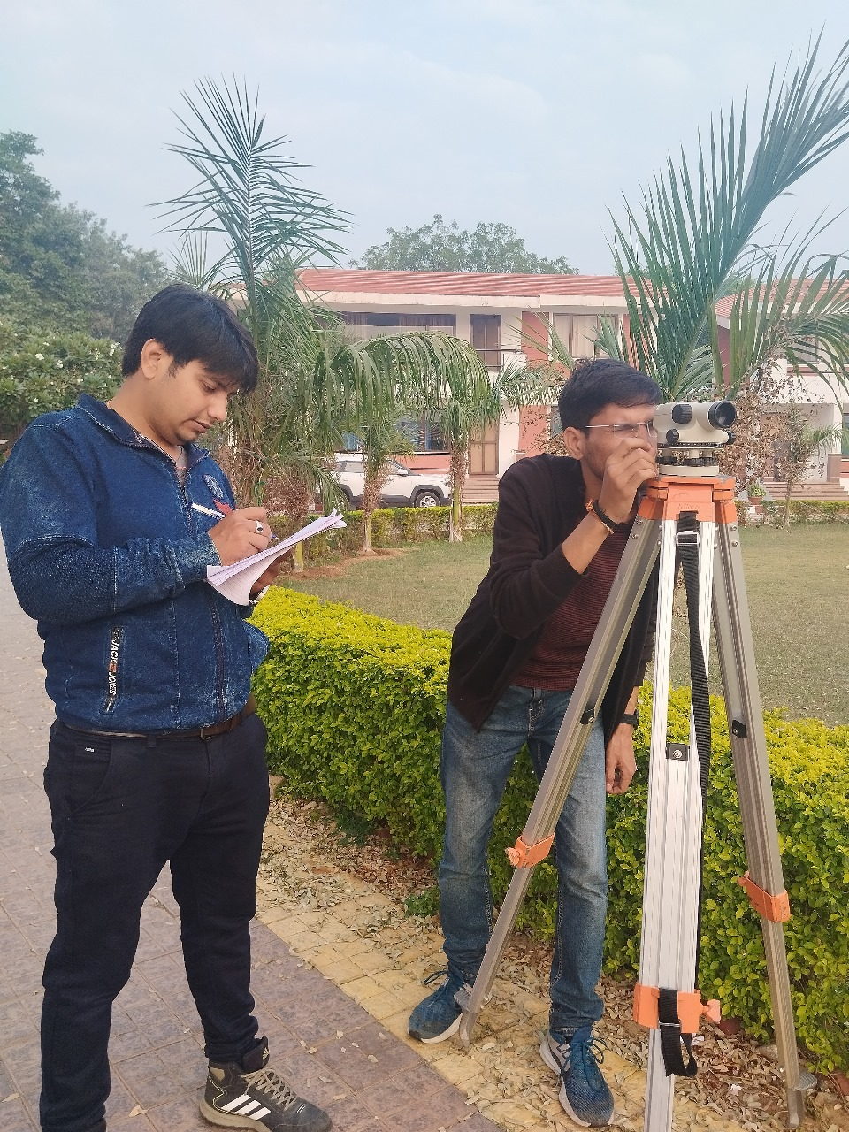
Levelling using Auto-Level
Objective: To transfer the level from BM to various control points.
Height of collimation method for calculations levels
Arithmetic Check: ∑BS - ∑FS = Last RL – First RL = -0.002
Precise levelling . C = 2.95366 < 4
Least Count Of Staff used : 10 mm

Slide 9
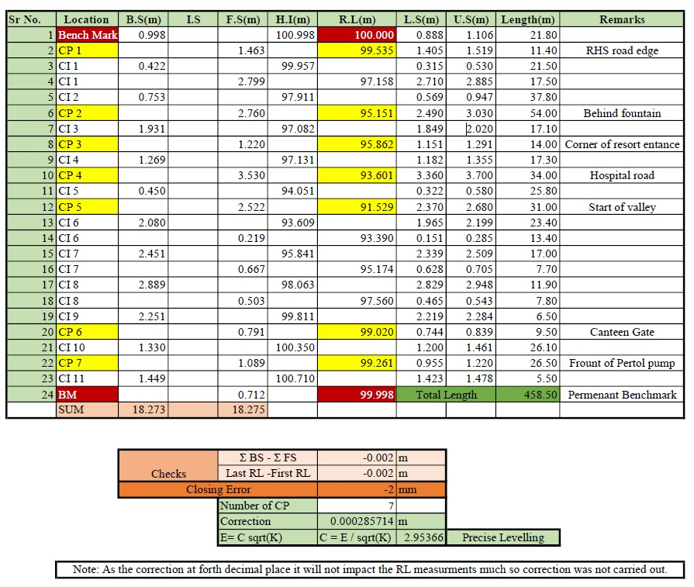

Slide 10
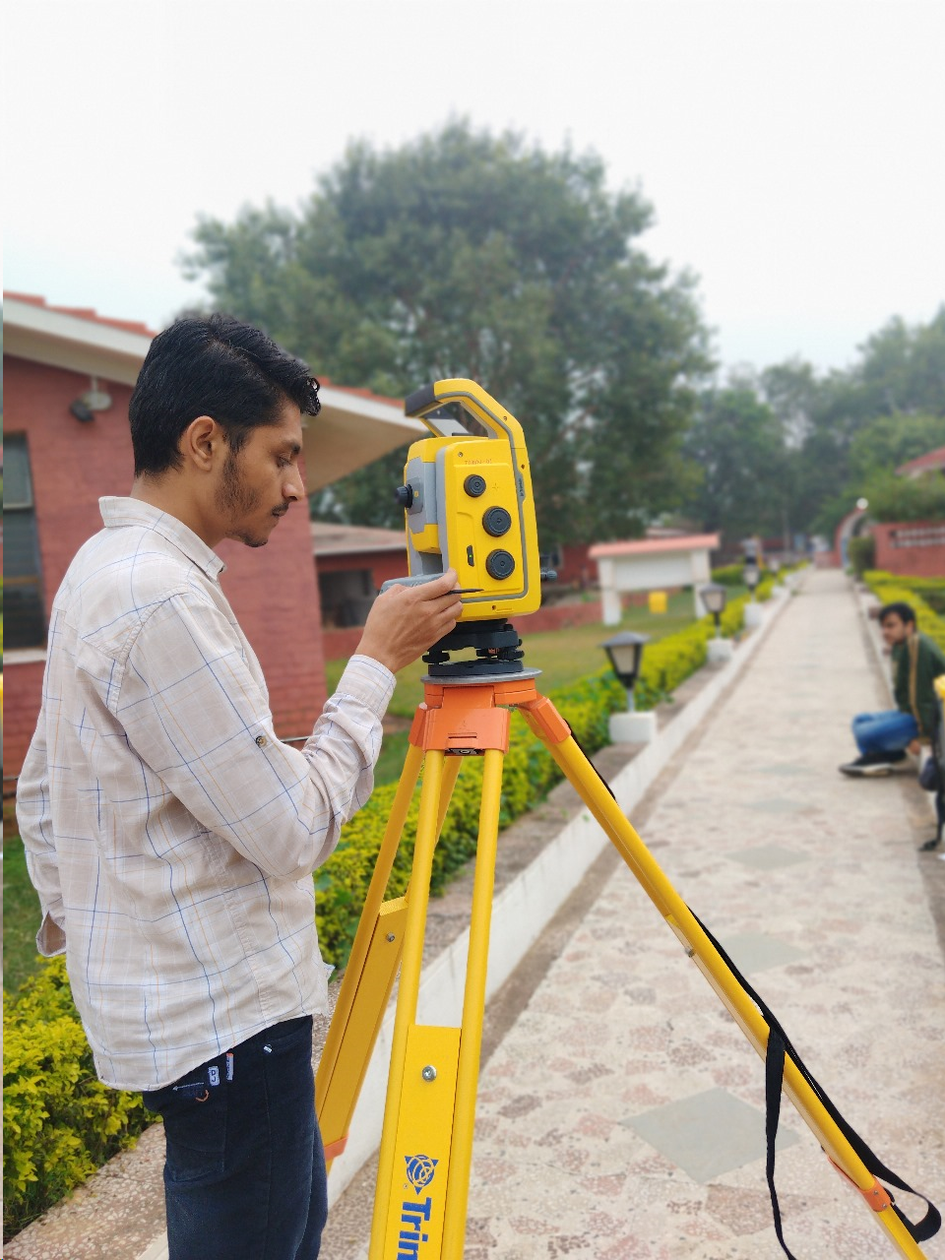
Feature Mapping using TS
Setting-up of instrument.
Orientation of instrument w.r.t control coordinates.
Created code for features and stated mapping the features respectively.
Exporting Data into .csv file.
Creating map on ArcGIS pro software.
Least Count:
Distance : 1 mm
Angle: 1 sec

Slide 11
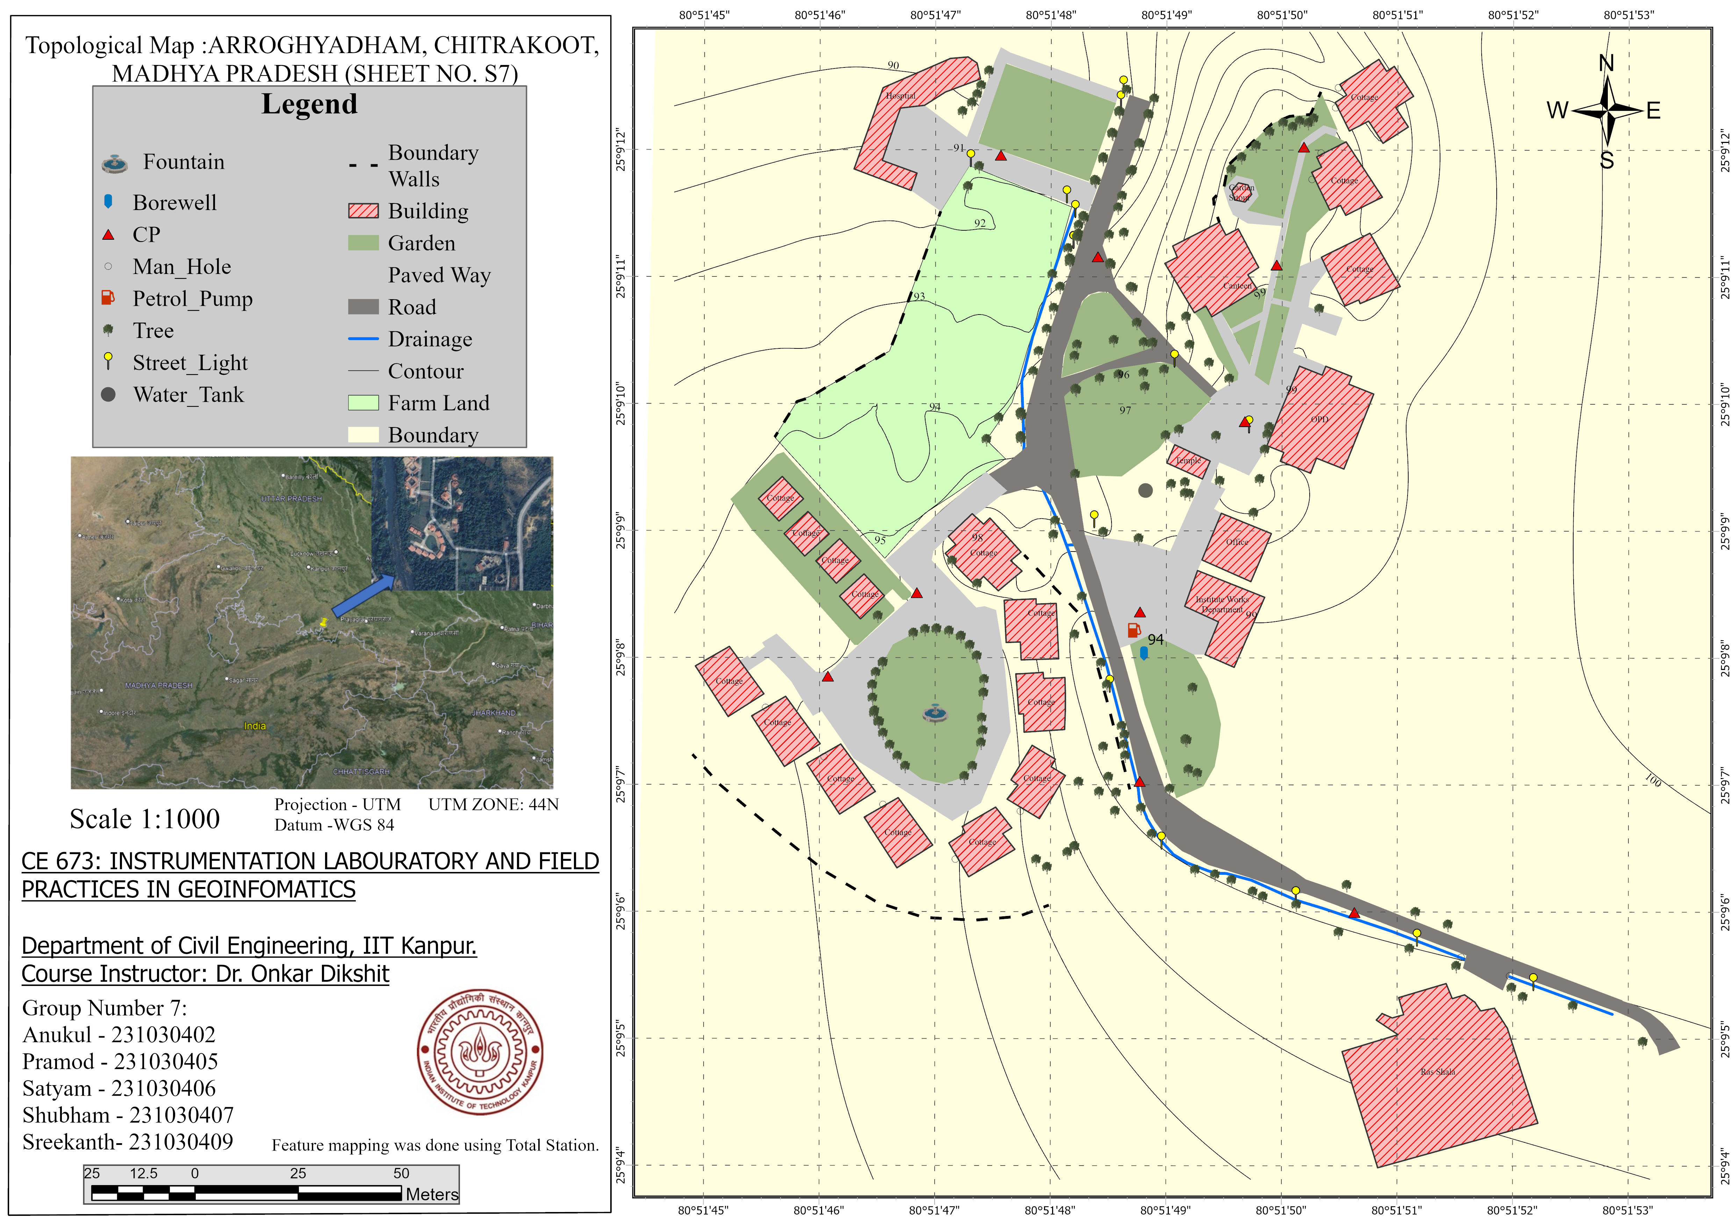
Scale : 1:1000
Contour Interval: 1 m

Slide 12
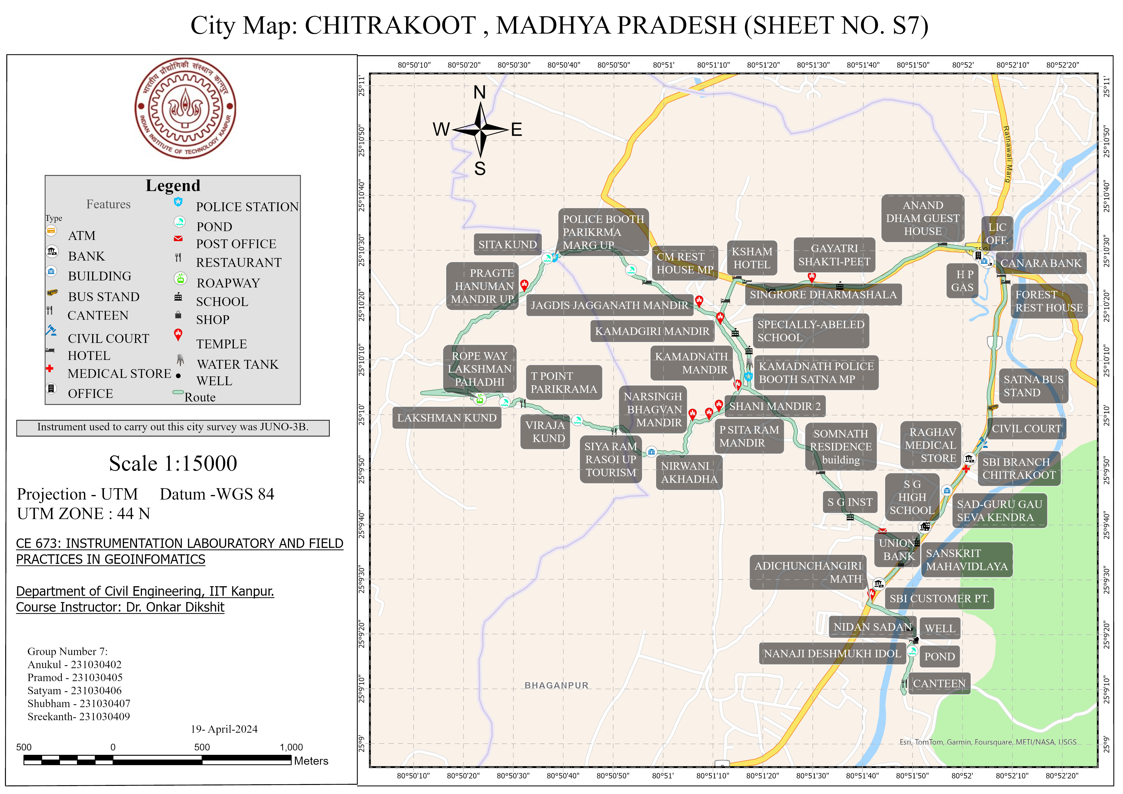
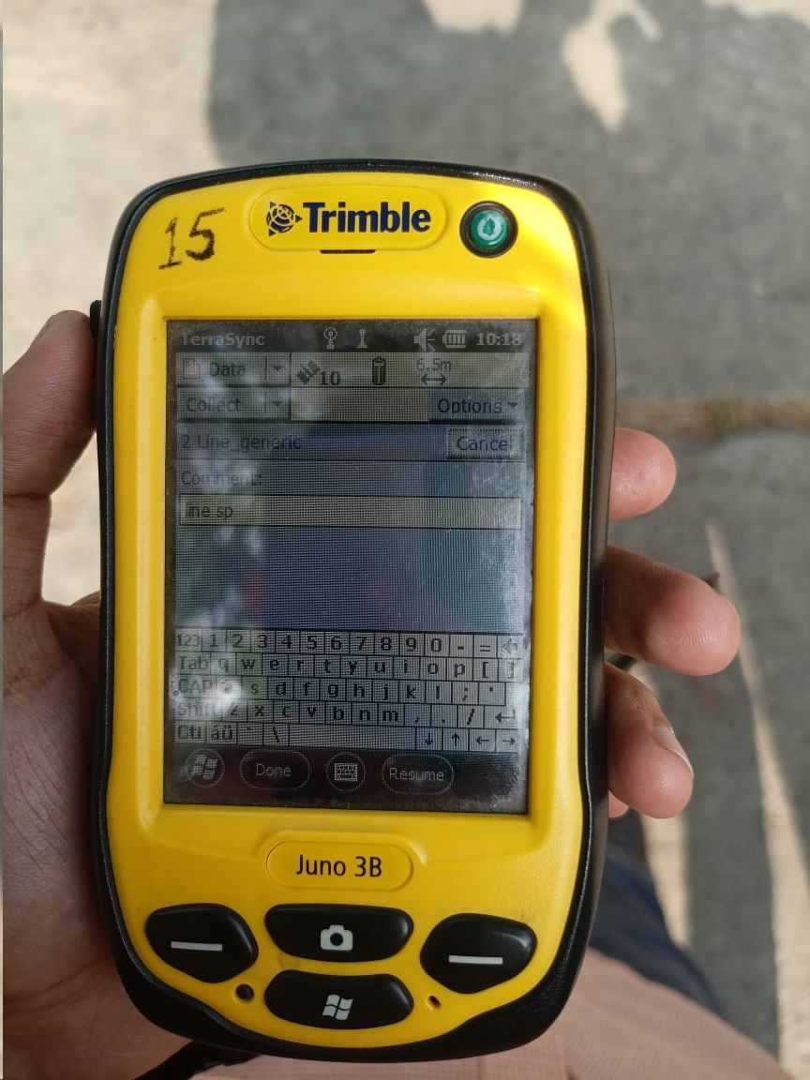
City Map Using Juno-3B
Hand Held Mapping Device.
Constellations Support: Only GPS.
Accuracy:
Pre- processing = 8 -10 m
Post processing = up to 2 m
Scale : 1:15000

Slide 13
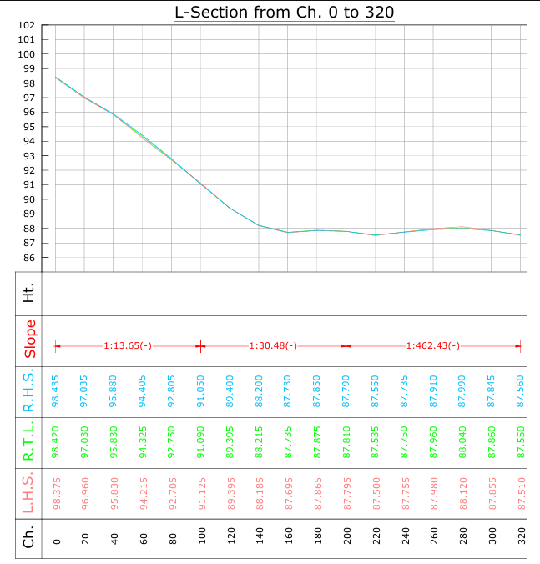
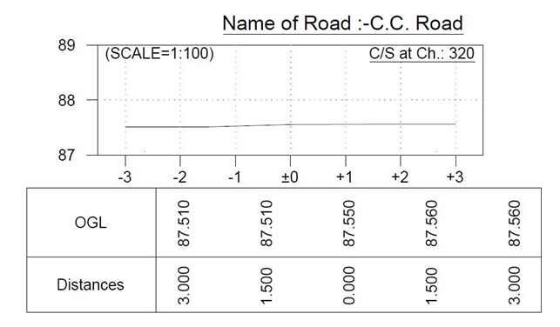
Road Profile
C/S Road.
Longitudinal section of Road

Slide 14
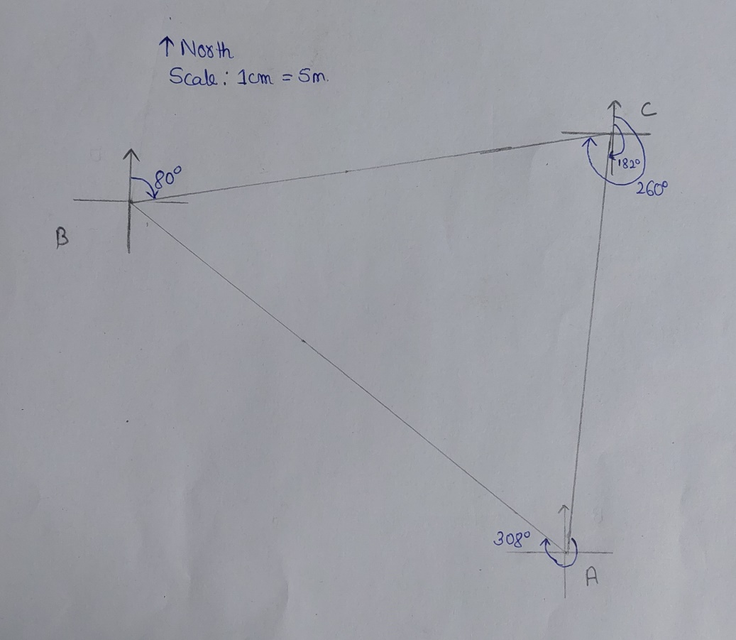
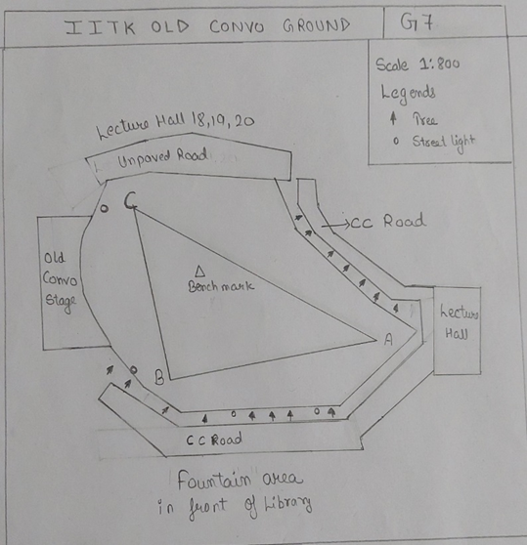
Lab- 1 Chain & Compass survey
Control network
Feature Map

Slide 15
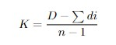
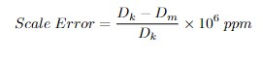
Lab- 2 EDMI calibration
Objective was finding cyclic error, instrument const. and the scale error.
Taking 30 meter long distance using tape.
Divide the distance in 20 meter and 10 meter which was divided into 10 part of 1 meter.
Equation for instrument const. is given by
Equation for scale error is given by

Slide 16
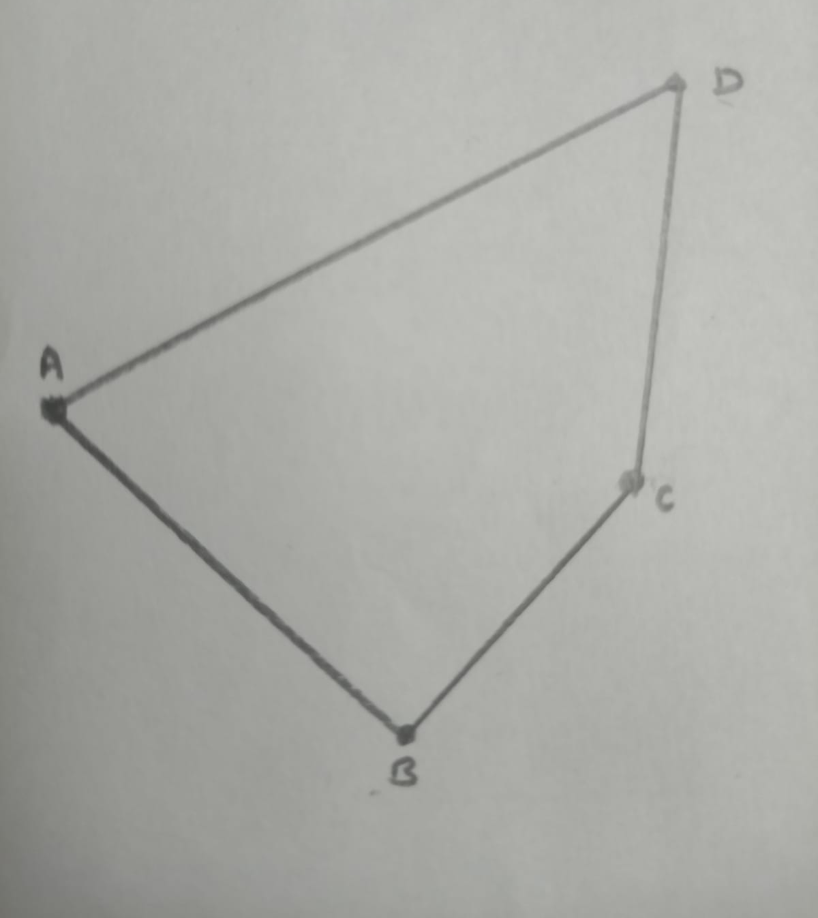
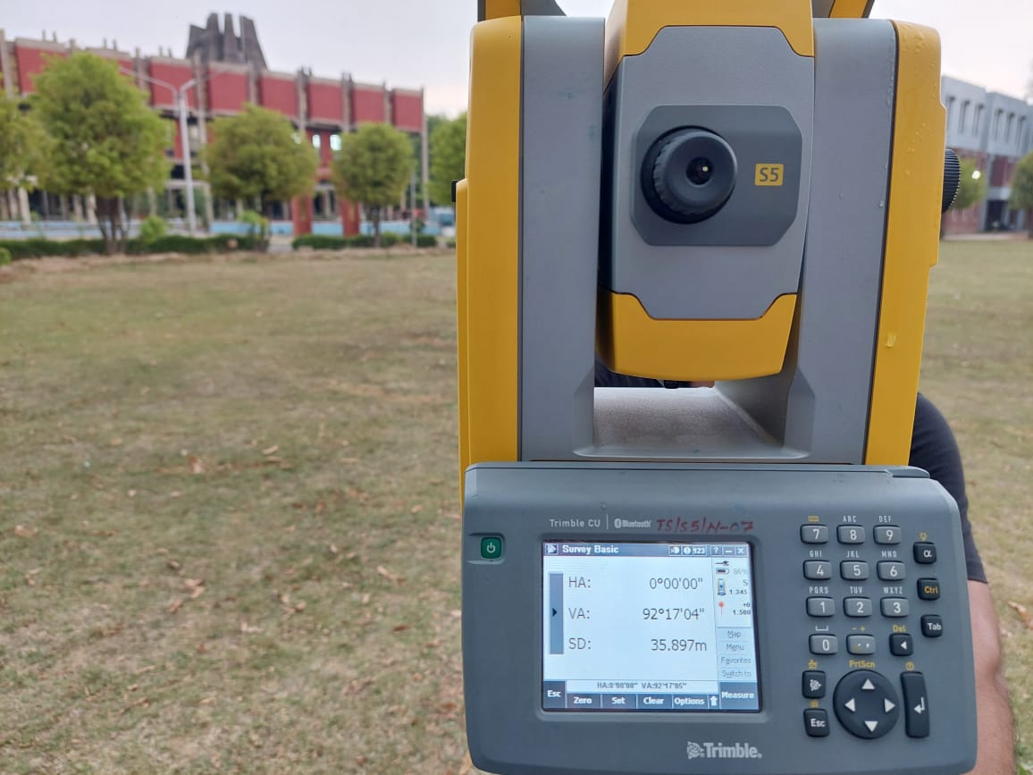
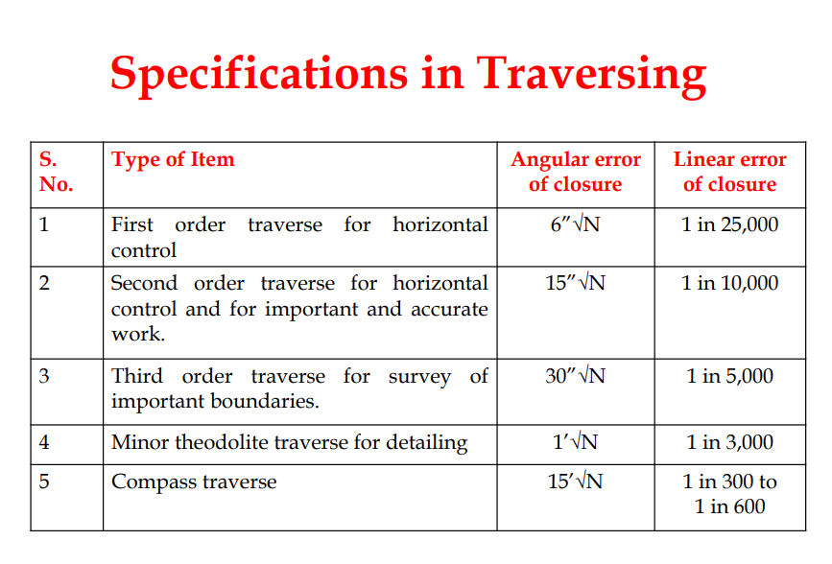
Lab- 3 Traversing using Total Station
LOCATION : Old Convo Ground
Taking Face left and Face right Reading of interior angle of traverse using total station
Third Order Precision because the closing error is 15.298 sec.

Slide 17
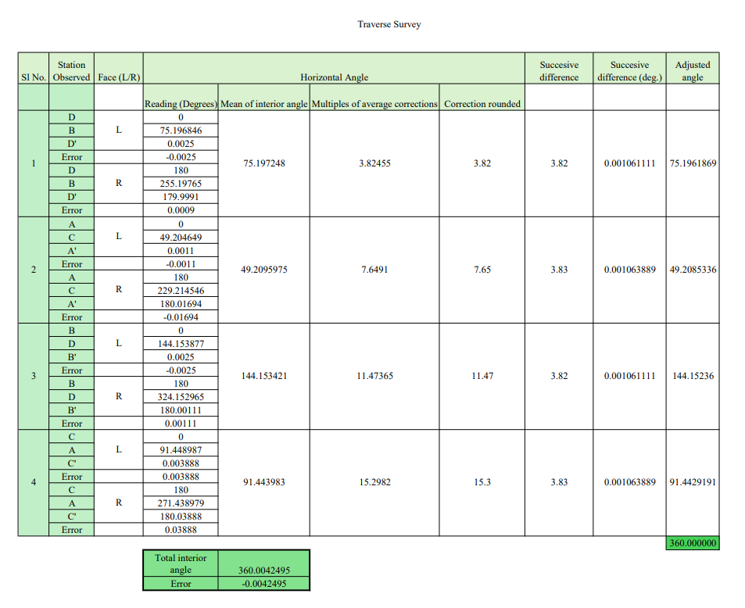

Slide 18
Conclusion
The camp provided comprehensive understanding of basic and advanced field surveying methods.
We learned to establish horizontal and vertical control
Practical knowledge on utilizing navigation receivers for data collection was imparted.
Proficiency in collecting and handling spatial data using various surveying instruments was achieved.
The camp provided an enriching experience, effectively bridging the divide between academic knowledge and practical application.

Slide 19
Reference
1. Wolf, P.R. and Ghilani, C.D., 2002, Elementary surveying, an introduction to geomatics, X edition, Prentice Hall: NJ.
2. Schofield, W. and Breach, M., 2007, Engineering surveying, VI edition, Butterworth: Oxford.
3. Anderson, J.M. and Mikhail, E.M., 1998, Surveying theory and practice, WCB McGraw: Boston.

Slide 20
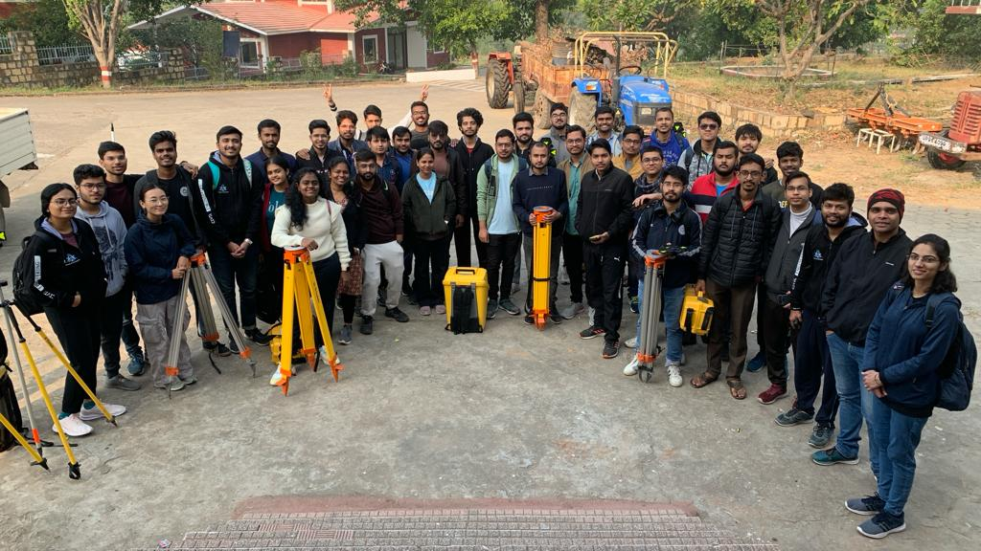

Thankyou!...

